Slide 1
Neural Networks
in Image Processing
Jakub Kuciński

Slide 2
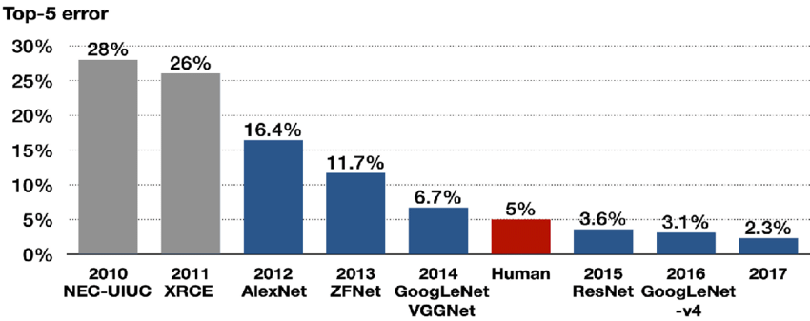
Algorithms that won the ImageNet Large Scale Visual Recognition Challenge (ILSVRC)
Kang, Dae-Young & Duong, Hieu & Park, Jung-Chul. (2020). Application of Deep Learning in Dentistry and Implantology. The Korean Academy of Oral and Maxillofacial Implantology. 24. 148-181. 10.32542/implantology.202015.

Slide 3
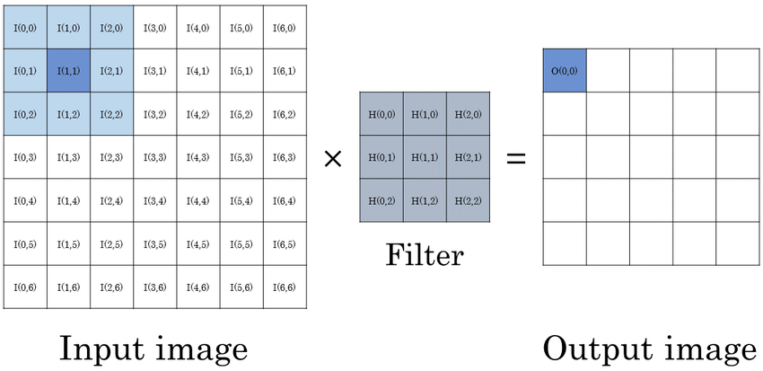
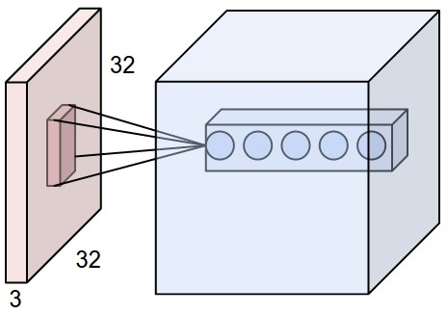
Convolutions
Why not fully connected layers?
(256 x 256 x 3)^2 = 38 654 705 664 parameters!!!
Baskin, Chaim & Liss, Natan & Mendelson, Avi & Zheltonozhskii, Evgenii. (2017). Streaming Architecture for Large-Scale Quantized Neural Networks on an FPGA-Based Dataflow Platform.

Slide 4


Pooling
Role of pooling:
decreases spatial size
make network less sensitive to exact location of features
enable convolutions to work on the bigger context of the image

Slide 5

Typical CNN architecture for classification

Slide 6
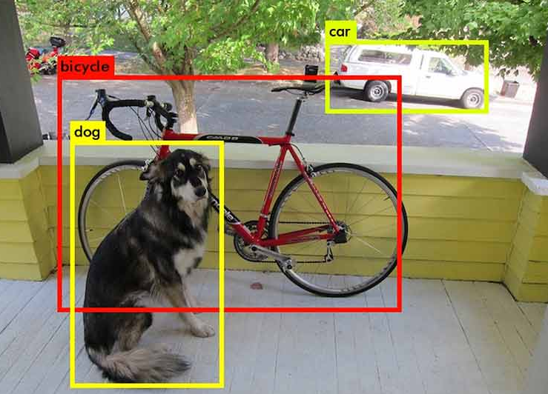
Object detection

Slide 7
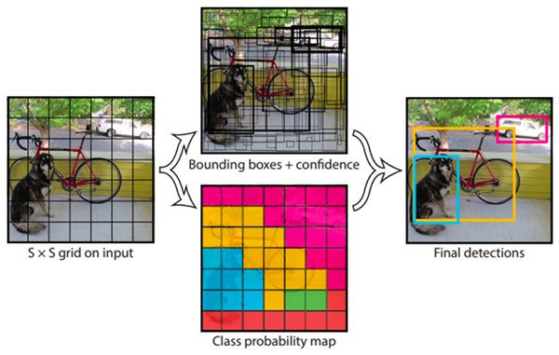
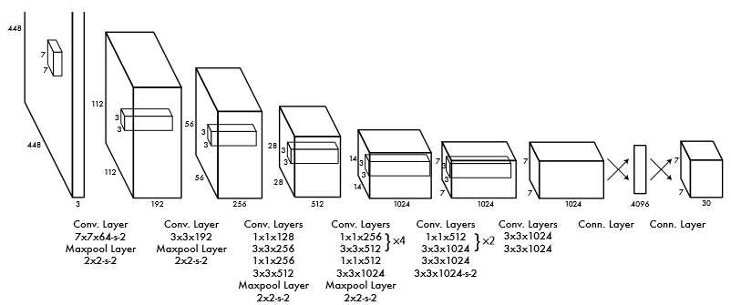
One stage detectors - YOLO
Joseph Redmon and Santosh Divvala and Ross Girshick and Ali Farhadi, You Only Look Once: Unified, Real-Time Object Detection

Slide 8
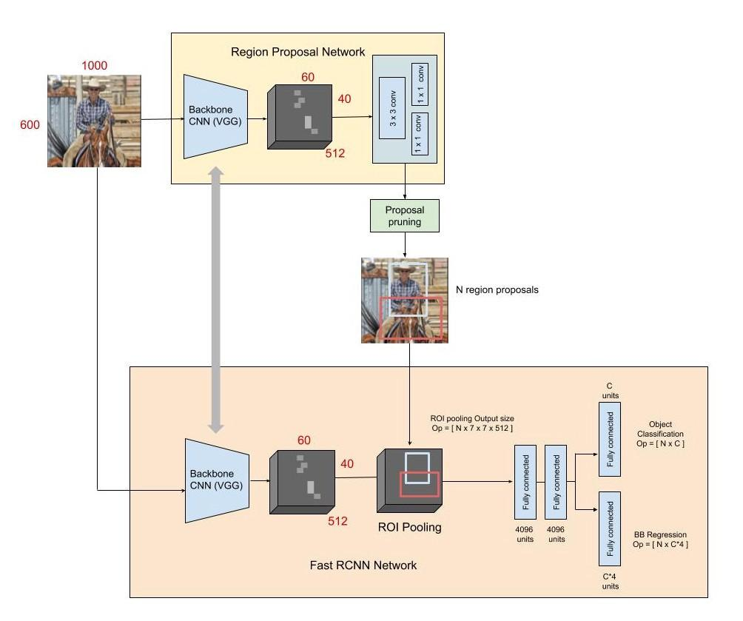
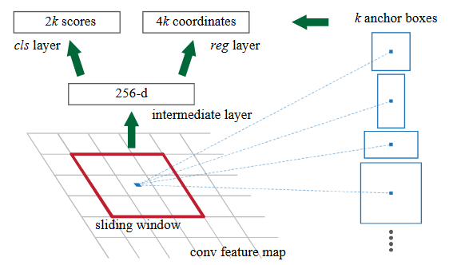
Two stage detectors - Faster R-CNN
Shaoqing Ren and Kaiming He and Ross Girshick and Jian Sun, Faster R-CNN: Towards Real-Time Object Detection with Region Proposal Networks
Shilpa Ananth, Faster R-CNN for object detection

Slide 9
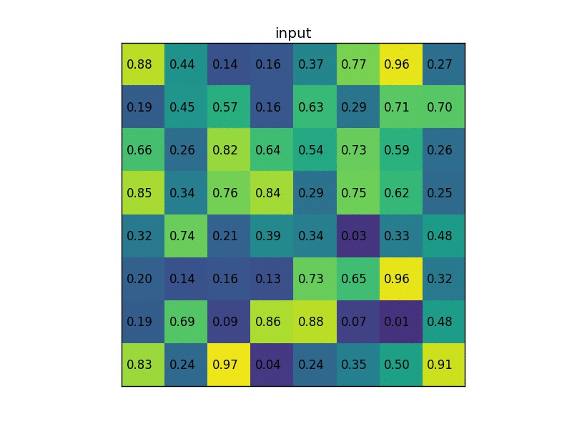
RoI Pool

Slide 10
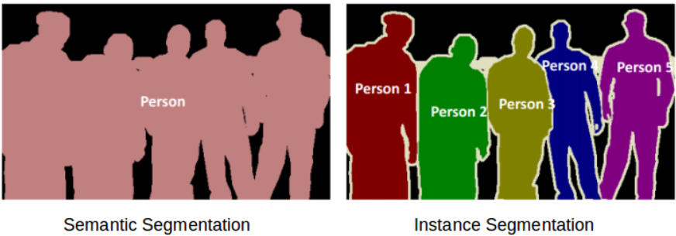
Image segmentation

Slide 11
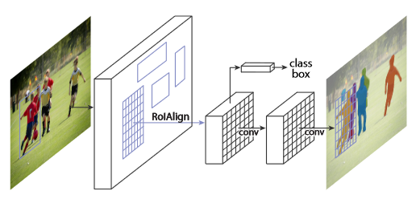
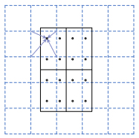
Mask R-CNN
RoIAlign
Kaiming He and Georgia Gkioxari and Piotr Dollár and Ross Girshick, Mask R-CNN

Slide 12
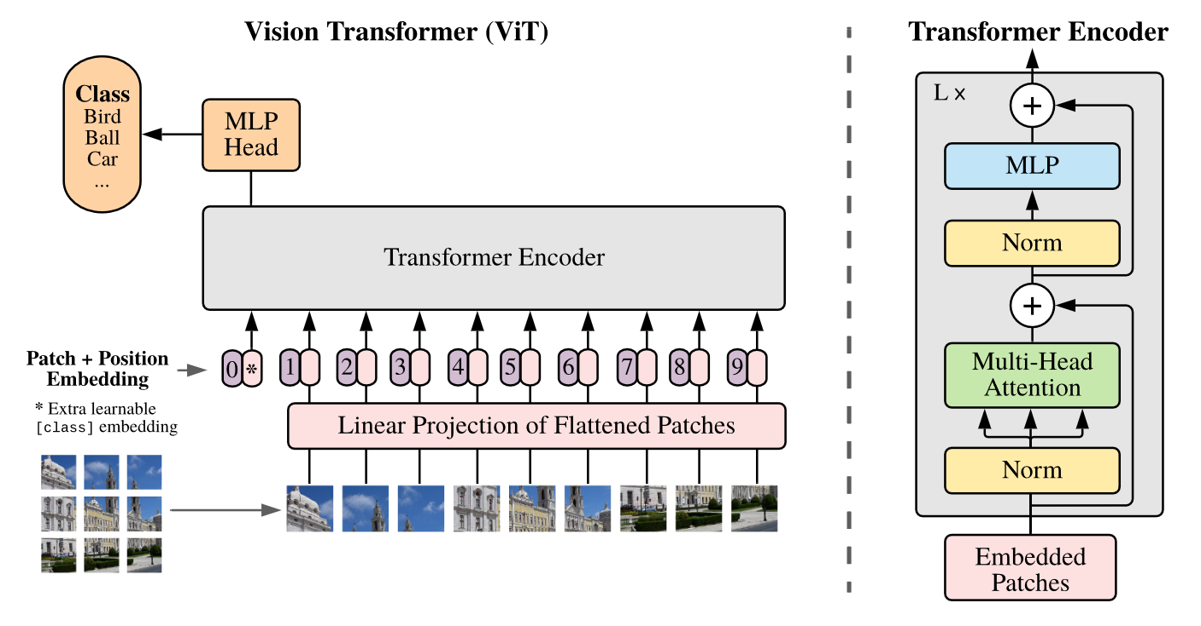
Vision Transformer
Alexey Dosovitskiy et al. (3 Jun 2021), An Image is Worth 16x16 Words: Transformers for Image Recognition at Scale

Slide 13
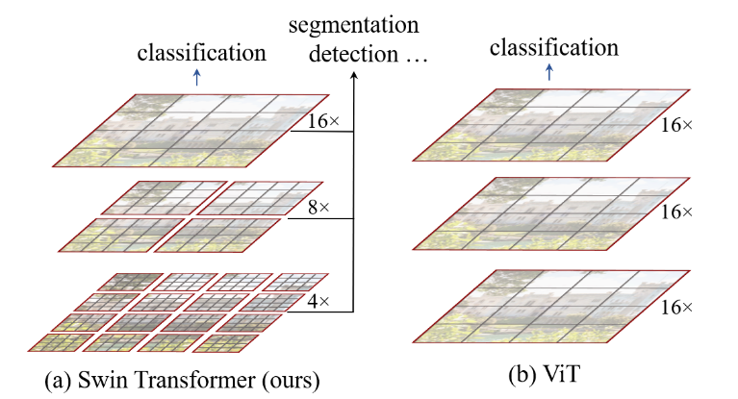
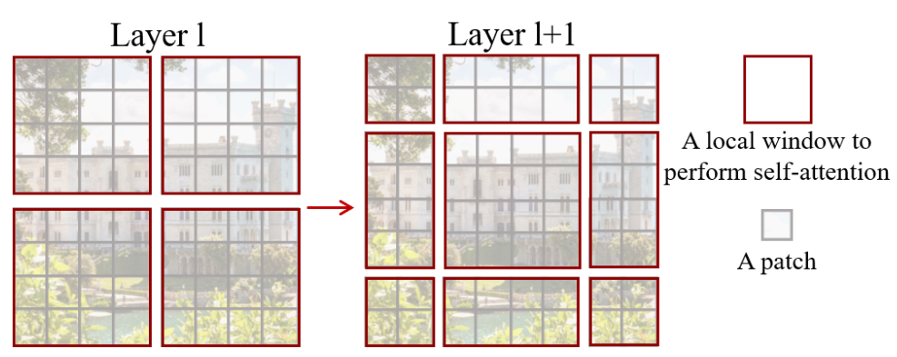
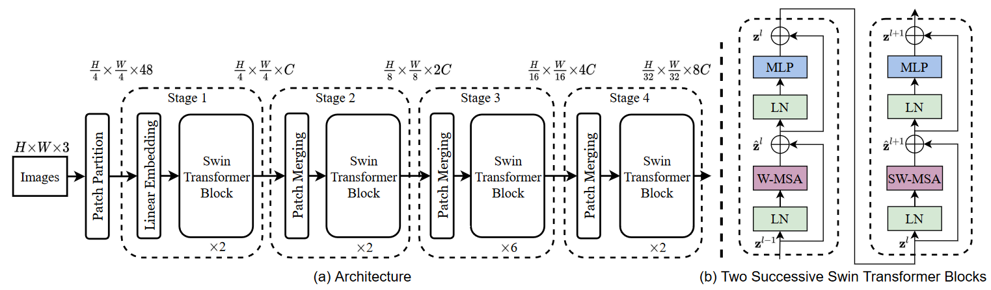
Swin Transformer

Slide 14
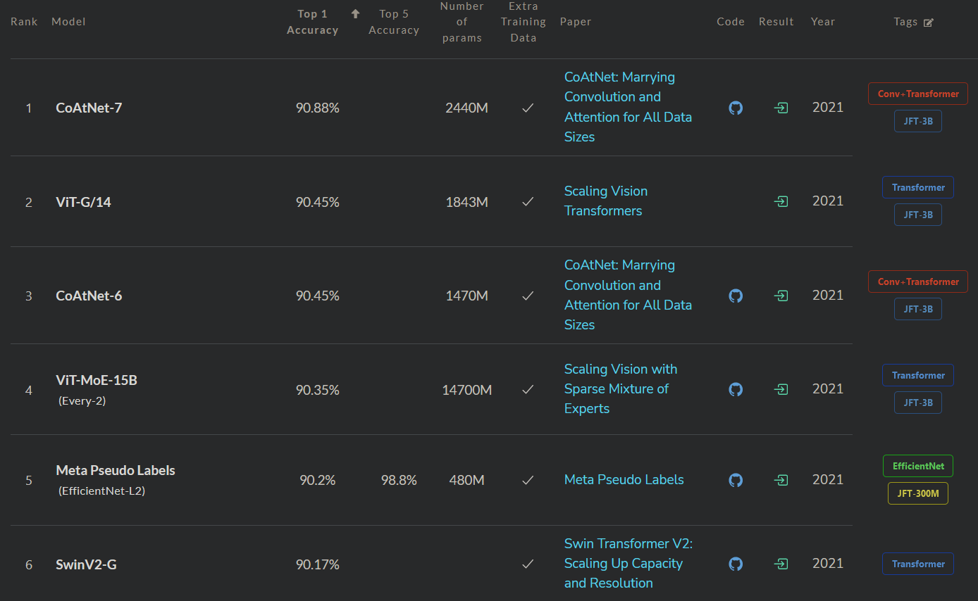
Image Classification on ImageNet
https://paperswithcode.com/sota/image-classification-on-imagenet

Slide 15
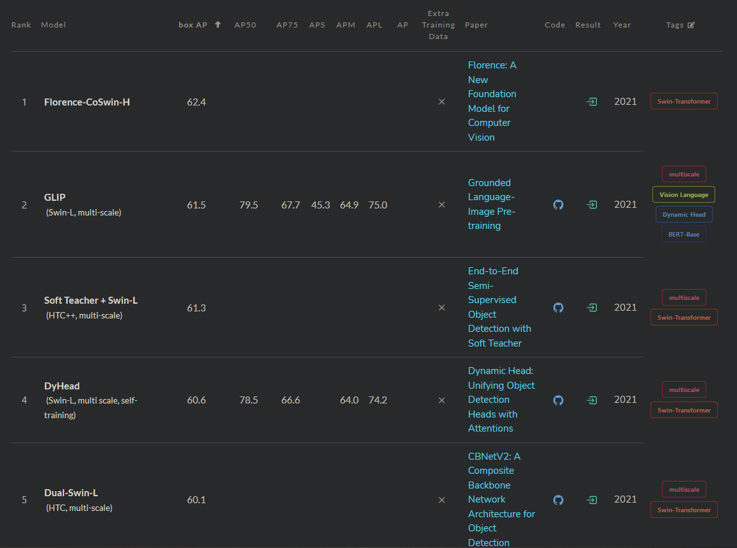
Object Detection on COCO test-dev
https://paperswithcode.com/sota/object-detection-on-coco

Slide 16
Recent trends and findings
ViTs needs very long training (probably due to big sparsity of attention layers and thus difficulty to learn first layers - because of fading gradient) and strong data augmentations to achieve their potential.
More stable architectures, training schedules and proper data augmentations for ViTs are findings of the last year.
Training CNNs to reasonably good performance is easier than ViTs, but training ViTs to close State-of-the-Art performance is easier than CNNs (probably due to inductive bias of CNNs in sense of local connectivity).
Convnets if designed and trained carefully and precisely can achieve similar performance as ViTs.
A ConvNet for the 2020s
Data augmentation is crucial for proper training any architecture for specific task.
Simple Copy-Paste is a Strong Data Augmentation Method for Instance Segmentation
New strong data augmentations for mixing data samples: CutMix, MixUp, FMix. Especially useful when training CNNs on limited data.
Cutmix-vs-Mixup-vs-GridMask-vs-CutOut
FMix: Enhancing Mixed Sample Data Augmentation
Creating special architectures and training models on different tasks or even different domains (e.g. images and text) are becoming more and more popular as it can allow to increase general performance and improve accuracy in few or zero-shot learning due to access to additional data and advance generalization.
Grounded Language-Image Pre-training, Florance, CLIP, Multimodal Neurons in NN, DALL·E, Perceiver IO

Slide 17
Additional slides

Slide 18




Different types of convolutions
No padding, no stride
Full padding, no stride
No padding, strides
Dilation
Vincent Dumoulin, Francesco Visin - A guide to convolution arithmetic for deep learning

Slide 19
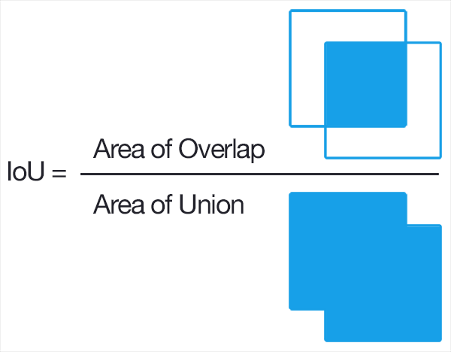
Intersection over Union (IoU) - training
In YOLO training:
If the center of an object falls into a grid cell, that grid cell is responsible for detecting that object.
We bind ground truth box with the predicted box of greatest IoU and train only cells with such selected boxes.
In Faster R-CNN RPN training:
We train only on positive and negative predicted boxes.
Positive sample if it has the highest or greater than 0.7 IoU with any ground truth box.
Negative sample if IoU with all ground truth boxes is less than 0.3.

Slide 20
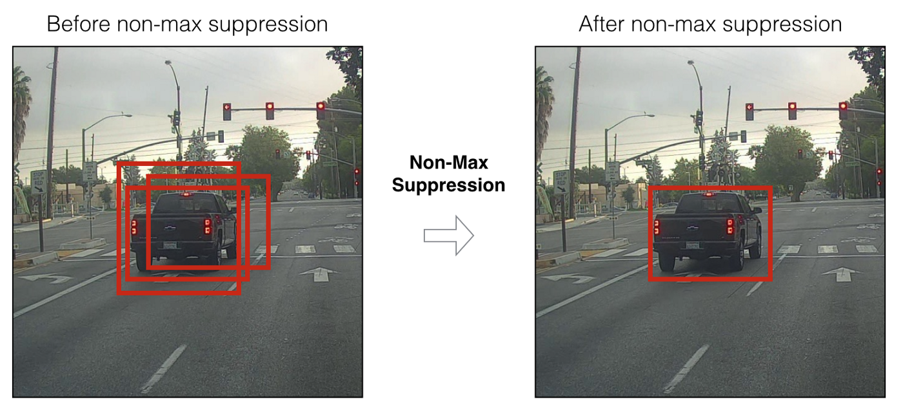
Non-maximum Suppression (NMS) - testing
At inference we assume that we don’t have ground truth boxes and our model returns much more boxes than there are objects at the image. We need to somehow select the right box and discard excessive ones. One can use NMS for that purpose. It can be described as follows:
Select box with highest confidence from proposals, add it to results and remove from proposals.
Remove all proposal boxes that have IoU greater than the threshold with the selected box.
Repeat until there are no more proposals.
NMS can be applied class-wise. It is also used in the proposal selection from RPN network in Faster-RCNN. There are some improved variants of NMS e.g. Soft-NMS.

Slide 21
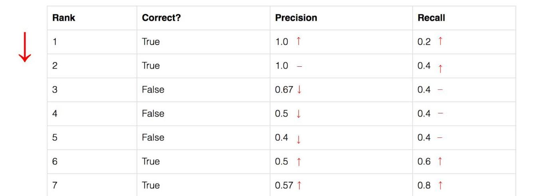
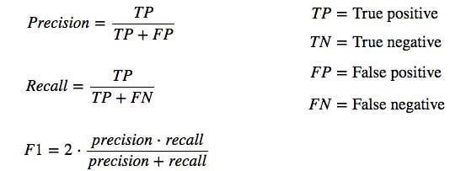
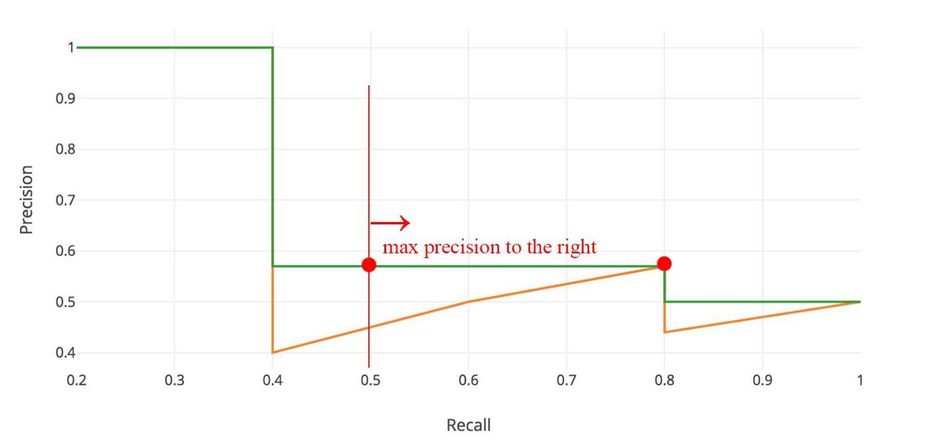
Average Precision (AP) and mean Average Precision (mAP)
Box prediction is correct if IoU > threshold
Orange curve represents the data in order of increasing recall. Green is orange curve after projection. AP is the integral under green curve.
mAP is the mean of AP for different values of IoU threshold. For COCO benchmark it is of 0.5 to 0.95 with a step of 0.05.
https://jonathan-hui.medium.com/map-mean-average-precision-for-object-detection-45c121a31173

Slide 22
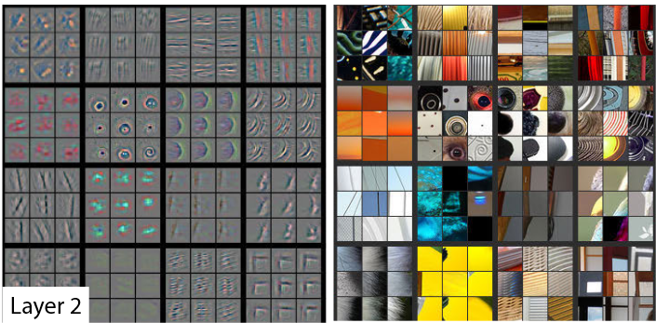
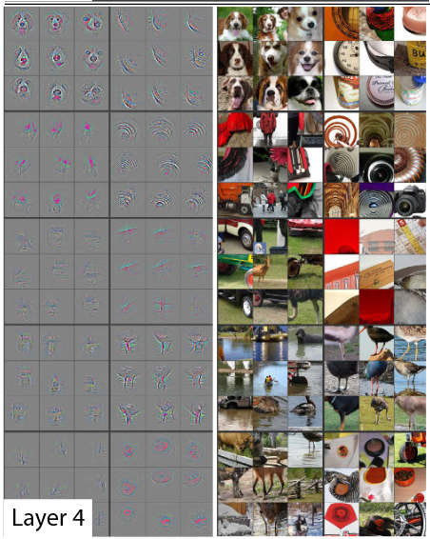
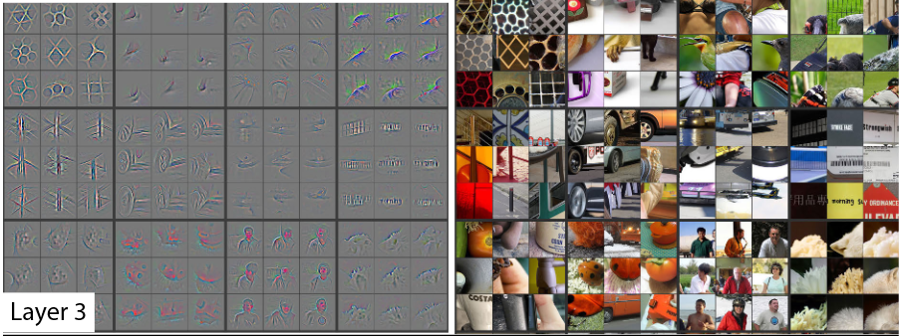
CNNs visualization
Matthew D. Zeiler and Rob Fergus, Visualizing and Understanding Convolutional Networks

Slide 23
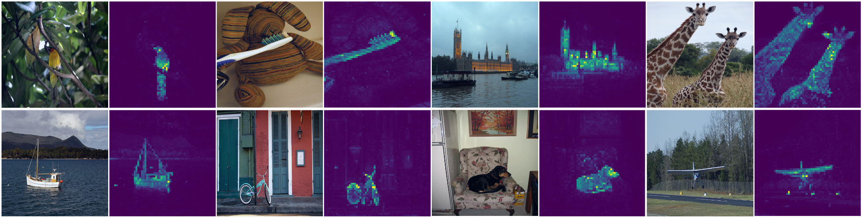
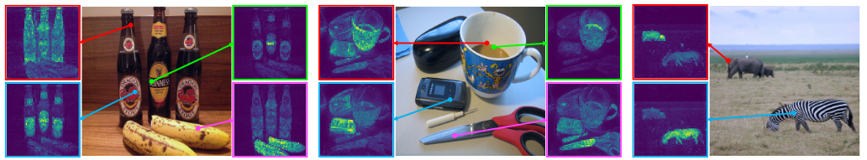
ViTs visualization
Mathilde Caron et al., Emerging Properties in Self-Supervised Vision Transformers

